Slide 1
SENTIMENT ANALYSIS ON Tweets
By [Author]

Slide 2
Introduction
I trained a sentiment analysis model on Twitter’s post by users to detect if their tweet has a positive connotation to it. We also demonstrate the model in real-time on stage through an interactive model.
After training, the model is saved to disc in the “sentiment_model.pkl” file.
I used NLTK to build this model. The Natural Language Processing Tool Kit (NLTK) is a platform used for building Python programs that work with human language data for applying statistical natural language processing (NLP).

Slide 3
What is sentiment analysis
The act of computationally recognizing and categorizing opinions stated in a piece of text, especially in order to discern whether the writer has a good, negative, or neutral attitude toward a given topic, product, etc.

Slide 4
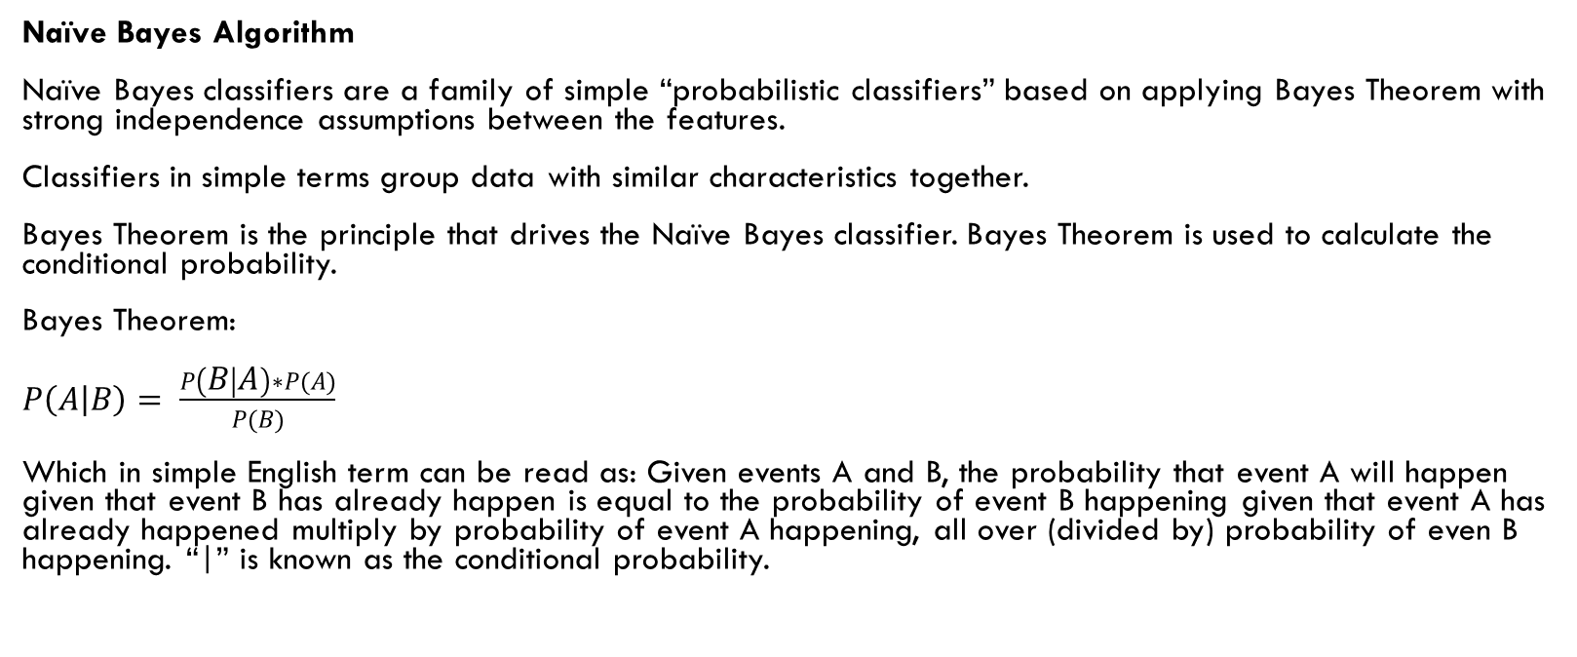
Algorithm review
Naïve Bayes Algorithm
Naïve Bayes classifiers are a family of simple “probabilistic classifiers” based on applying Bayes Theorem with strong independence assumptions between the features.
Classifiers in simple terms group data with similar characteristics together.
Bayes Theorem is the principle that drives the Naïve Bayes classifier. Bayes Theorem is used to calculate the conditional probability.
Bayes Theorem:
$P\left(A | B\right)= \frac{P\left(B | A\right)∗P(A)}{P(B)}$
Which in simple English term can be read as: Given events A and B, the probability that event A will happen given that event B has already happen is equal to the probability of event B happening given that event A has already happened multiply by probability of event A happening, all over (divided by) probability of even B happening. “|” is known as the conditional probability.

Slide 5
how is the Bayes Theorem used for classification? Good Question
Imagine a spam filtering systems, with x is the text to be classified (i.e. x = {text data}) and y is the classification of the text (i.e. y= {1, 0}, where y = 1 for a text labelled as spam and y = 0 for a text labelled as not spam).
Therefore, the probability of x being a spam (y = 1) given text x, is equal to the probability of text x given that text x is a spam multiply by the probability of spams (y = 1) all over probability of x.
And the probability of x not being a spam (y = 0) given text x, is equal to the probability of text x given that text x is not a spam multiply by the probability of not spams (y = 0) all over probability of x.
To classify the text x, we take the probability (i.e. the probability between the probability of x being a spam (y = 1) given text x and the probability of x not being a spam (y = 0) given text x) with the highest result as facts. The probability is called “Likelihood”, and this is gotten from the data this model trains on.

Slide 6
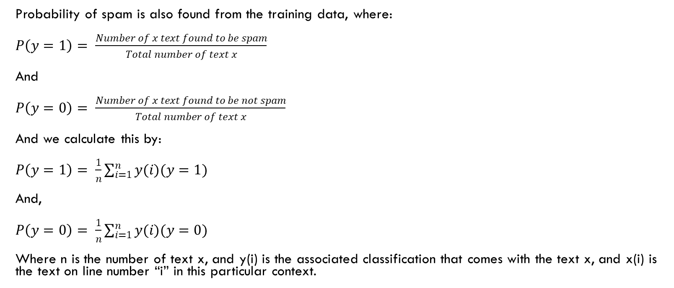
how is the Bayes Theorem used for classification? [Continuation]
Probability of spam is also found from the training data, where:
$P\left(y=1\right)= \frac{Number of x text found to be spam}{Total number of text x}$
And
$P\left(y=0\right)= \frac{Number of x text found to be not spam}{Total number of text x}$
And we calculate this by:
$P\left(y=1\right)= \frac{1}{n}\sum_{i=1}^{n}{y(i)(y=1)}$
And,
$P\left(y=0\right)= \frac{1}{n}\sum_{i=1}^{n}{y(i)(y=0)}$
Where n is the number of text x, and y(i) is the associated classification that comes with the text x, and x(i) is the text on line number “i” in this particular context.

Slide 7
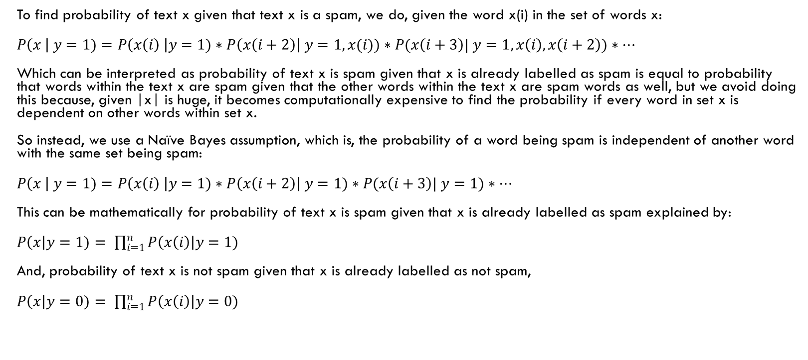
how is the Bayes Theorem used for classification? [Continuation]
To find probability of text x given that text x is a spam, we do, given the word x(i) in the set of words x:
$P\left(x \right| y=1)=P\left(x\left(i\right) \right|y=1)∗P\left(x\left(i+2\right)\right| y=1, x(i))∗P(x\left(i+3\right)| y=1, x\left(i\right), x\left(i+2\right))∗…$
Which can be interpreted as probability of text x is spam given that x is already labelled as spam is equal to probability that words within the text x are spam given that the other words within the text x are spam words as well, but we avoid doing this because, given |x| is huge, it becomes computationally expensive to find the probability if every word in set x is dependent on other words within set x.
So instead, we use a Naïve Bayes assumption, which is, the probability of a word being spam is independent of another word with the same set being spam:
$P\left(x \right| y=1)=P\left(x\left(i\right) \right|y=1)∗P\left(x\left(i+2\right)\right| y=1)∗P(x\left(i+3\right)| y=1)∗…$
This can be mathematically for probability of text x is spam given that x is already labelled as spam explained by:
$P\left(x\right|y=1)= \prod_{i=1}^{n}{P\left(x\left(i\right)\right|y=1)}$
And, probability of text x is not spam given that x is already labelled as not spam,
$P\left(x\right|y=0)= \prod_{i=1}^{n}{P\left(x\left(i\right)\right|y=0)}$

Slide 8
STATS
Dataset Size: 31,962 Tweets
Dataset Gotten from: Kaggle [https://www.kaggle.com/datasets/arkhoshghalb/twitter-sentiment-analysis-hatred-speech?select=train.csv]
Accuracy of model: 94.94949494949495%

